Slide 1
The Challenges and Opportunities of ICT in the Post Covid19 World
LASU 15TH VIRTUAL PUBLIC LECTURE
PRESENTER: Mr. OJEDIRAN Alaba Bolaji MCFI

Slide 2
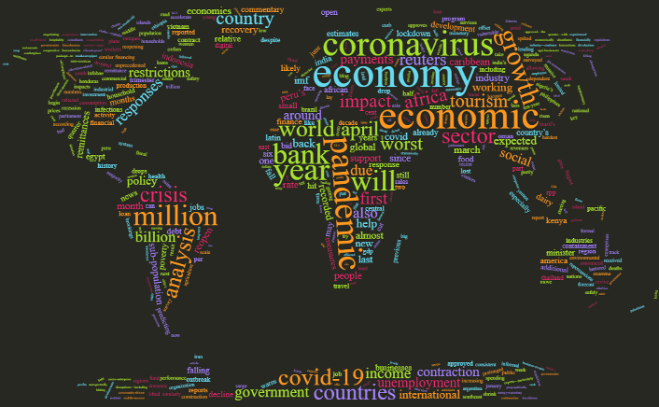
THE POST COVID19 WORLD
We expect that the COVID-19 threat will eventually fade off, as the Ebola, Zika, and Severe Acute Respiratory Syndrome (SARS) viruses have in past years.
However, social-economic impact will still be felt long after the virus.

Slide 3
ICT in the Post Covid19 World is a case of
DISTRUPTION
INNOVATION
New knowledge

Slide 4
THE CHALLENGES
INSUFFICIENT DIGITAL SKILLS
NETWORK SECURITY THREAT
INADEQUATE & COSTLY INFRASTRUCTURE
DEFICIT OF DECISION DATA IN AFRICA

Slide 5
THE CHALLENGES contd.
INSUFFICIENT DIGITAL SKILLS
Notes:
Today, as we stare at a new normal where physical interactions are replaced by virtual existence, we realize that we need more action on digital inclusion and we need it now.With a large section of global population still lacking basic digital skills, are we ready to move online as a society? Probably not.

Slide 6
THE CHALLENGES contd.
NETWORK SECURITY THREAT
Out of the top 10 risk of the post covid-19 world in Nigeria, Network Security Threat (cybersecurity risk) has risen to number 4, from number 11 in 2018/2019.

Slide 7
THE CHALLENGES contd.
INADEQUATE & COSTLY INFRASTRUCTURE
Educational sector are challenged due to poor infrastructure for digital adoption
Out of the top 10 risk of the post covid-19 world in Nigeria, Technology Infrastructure Risk has also risen to number 6, from number 22 in 2018/2019.

Slide 8
THE CHALLENGES contd.
DEFICIT OF DECISION DATA IN AFRICA
African policy makers are increasingly called on to use evidence-based research to inform development decisions. But this requires the rigorous collection of data as well as a coordinated system to disseminate it.
Data, and especially data of good quality, are essential for national governments and institutions to accurately plan, fund and evaluate development activities. it is data that will provide more certainty amidst an uncertain and fast-changing environment.
Notes:
PROLIFERATION OF DATA SOURCES is increasing the occurrences of FAKE NEWS

Slide 9
THE OPPORTUNITIES
BOARDERLESS SCHOOLS BEYOND GEOGRAPHIC BOUNDARIES
NEW & FLEXIBLE CAREER
OPPORTUNITIES
IMPROVED BUSINESS
CONTINUITY
INCREASED DIGITALIZATION, AUTOMATION AND ANALYSIS
Notes:
DECISION DATA DEFICIT IN AFRICA (PROLIFERATION OF DATA SOURCES & FAKE NEWS )
African policy makers are increasingly called on to use evidence-based research to inform development decisions. But this requires the rigorous collection of data as well as a coordinated system to disseminate it.
Data, and especially data of good quality, are essential for national governments and institutions to accurately plan, fund and evaluate development activities. it is data that will provide more certainty amidst an uncertain and fast-changing environment.
NETWORK SECURITY THREAT
Out of the top 10 risk of the post covid-19 world in Nigeria, Network Security Threat (cybersecurity risk) has risen to number 4 in 2019/2020, from number 11 in 2018/2019.
INFRASTRUCTURE
Educational sector are challenged due to poor infrastructure for digital adoption
Poor infrastructure in the Nigerian space for internet facilities and power.
Out of the top 10 risk of the post covid-19 world in Nigeria, Technology Infrastructure Risk has also risen to number 6 in 2019/2020, from number 22 in 2018/2019.

Slide 10
THE OPPORTUNITIES contd.
INCREASED DIGITALIZATION, AUTOMATION AND ANALYSIS
“People empowered by automation will bring us out of this crisis” (Forbes, April 10, 2020)
INDIVIDUAL: There is Huge need for Individuals who can Digitize and Automate business processes. This can be from Creating Google Forms, Customizing Templates, using Zero-Coding Automation Technology and Coding Technologies too.
It ensures better accuracy for an individual’s work,
increase speed & accuracy,
aggregate repetitive task,
ensure your schedule can continue running without you being physically present.
ORGANISATION: Fast cost savings, Improved compliance, Resilience in Processes and Business Continuity
Notes:
I agree with MIT Economics Professor Daron Acemoglu’s definition of the ‘right’ technology and ‘so-so’ technology. The right technology creates opportunities for higher quality work versus a zero-sum game of destroying jobs. An example of the right technology has been how typesetters have moved up the value chain with graphic design.
Most well-known automation technologies never replaced humans; instead, they took over tedious, dangerous and onerous tasks.
ORGANISATION: Fast cost savings, Improved compliance, Resilience in Processes
INDIVIDUAL: Need for Individuals who can Digitize and Automate business processes. This can be from Creating Google Forms, Customizing Templates, using Zero-Coding Automation Technology and Coding Technologies too. It ensures better accuracy for an individual’s work, increase speed & accuracy, aggregate repetitive task, ensure your schedule can continue running without you being physically present.

Slide 11
THE OPPORTUNITIES contd.
EDUCATION BEYOND GEOGRAPHIC BOUNDARIES
A skill-biased pandemic
Despite the world being a global village, there has been increased Connectedness beyond geographical boundaries, which was accelerated by the Covid19
Educational Institutions are expanding their reach by repackaging and offering online, targeted-skills courses that are of high demand by the industry & this peculiar economy demand [automation-complementing skills (the skills that automation relies on) e.g creativity, social intelligence] NOT automation-substituting skills (i.e., skills that machines can replace)
e.g Modularization of MBA a case study
Individuals with one needed skills or the other can organize online (WhatsApp, Zoom etc) coaching classes
Knowledge economy/Re-SKILLING is having a huge need cum opportunity
Notes:
Comparing the unemployment rates between April 2019 and April 2020, the unemployment rate for those with a bachelor’s degree or higher increased from 2.1 to 8.4 percent, while for those with only a high school education it increased from 3.4 to 17.3 percent.

Slide 12
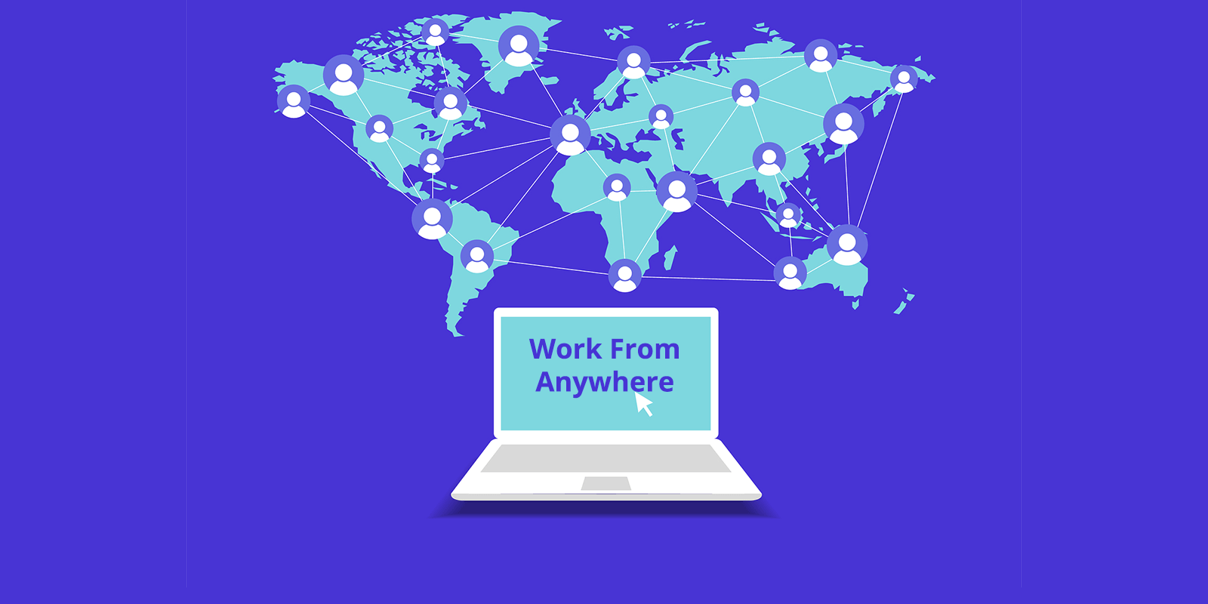
THE OPPORTUNITIES contd.
NEW & FLEXIBLE CAREER OPPORTUNITIES
VIRTUAL is the new normal

Slide 13
THE OPPORTUNITIES contd.
IMPROVED BUSINESS
CONTINUITY

Slide 14
THE OPPORTUNITIES
INCREASED GLOBAL CONNECTIVITY BEYOND GEOGRAPHIC BOUNDARIES
Zoom's network net worth jumped from $15b in December 2019 to $139b in October 2020. Thanks to the high demand for their virtual meeting app.
INCREASED DIGITALIZATION, AUTOMATION AND ANALYSIS
FinTech’s are having a field day. As we speak, conventional banking is an endangered specie. FinTech's are running them out of business. Transfers can now be done via WhatsApp in India.
AI and Analytics are experiencing better attention. Businesses are driving towards reducing human involvement as much as possible. This will turn attention to Artificial Intelligence. It will become mainstream, no longer an alternative.
Scenarios Planning increasingly powered by AI and automation enable organizations to see the bigger picture and make effective trade-off decisions on issues. By analyzing past events and hypothesizing future threats, organizations can identify strategic steps to take.
Notes:
Font size too small.
The example under connectivity is more of increased income. Not about geography
Increased digitization, etc. People want to know how that affects them, currently it is about big companies from this slides. Don’t forget that our focus is opportunities for people, most especially in education. Can you think about distance learning? Online coiaching classes, etc

Slide 15
TAKE AWAY & CONCLUSION
Automate strategic business processes to build resilience and business continuity
Workers & Individuals must RE-SKILL to meet up with current demands.
Aggregate data sources and get value from them with data analysis, visualization and artificial intelligence (AI)
Strengthen information technology infrastructure.
Conduct cyber-security assessment and implement the relevant remediation steps

Slide 16
THANK YOU FOR YOUR ATTENTION
alaba.ojediran@lasu.edu.ng
https://www.linkedin.com/in/ojediran-alaba-bolaji-mcfi-8269961b/

Slide 17
References
https://home.kpmg/xx/en/blogs/home/posts/2020/03/covid-19-data-deficit.html
https://assets.kpmg/content/dam/kpmg/ng/pdf/advisory/top-10-business-risks-in-2020-2021.pdf
https://qz.com/africa/762729/poor-data-is-hurting-african-countries-ability-to-make-good-policy-decisions/
https://www.economist.com/middle-east-and-africa/2020/05/07/lacking-data-many-african-governments-make-policy-in-the-dark
https://www.mckinsey.com/featured-insights/middle-east-and-africa/tackling-covid-19-in-africa#
https://www.weforum.org/agenda/2020/08/flexible-remote-working-post-covid19-company-predictions/
https://www.forbes.com/sites/shahinfarshchi/2020/04/10/expect-more-jobs-and-more-automation-in-the-post-covid-19-economy/?sh=6ab36c4629b4

